Slide 1


241C107 PROJECT – I

Slide 2
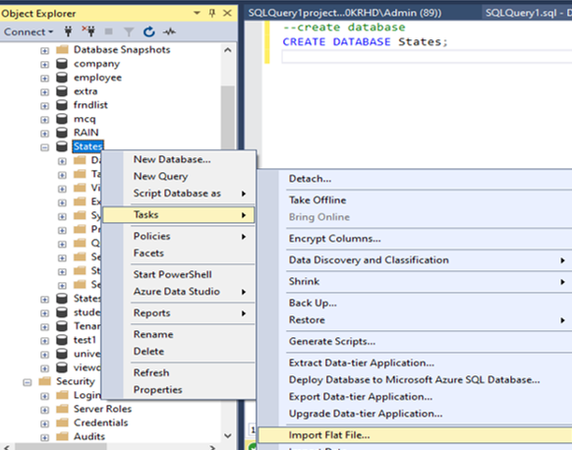
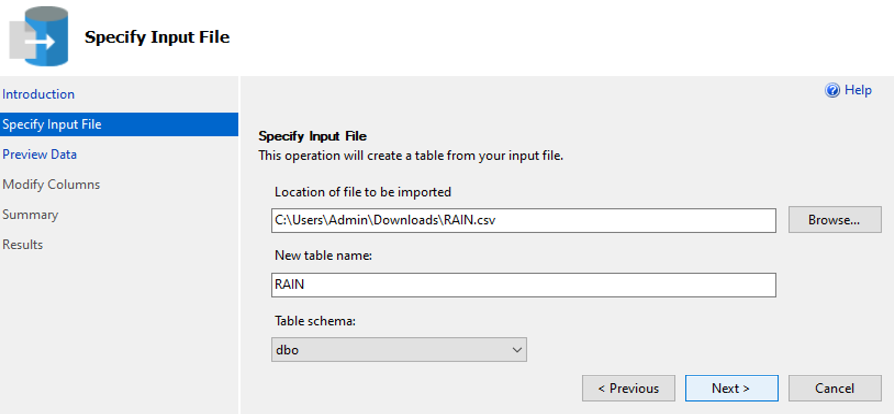
Create and Import Flat File
Create a database States -> States Database(right click) -> Tasks -> Import Flat File -> Specify input file.

Slide 3
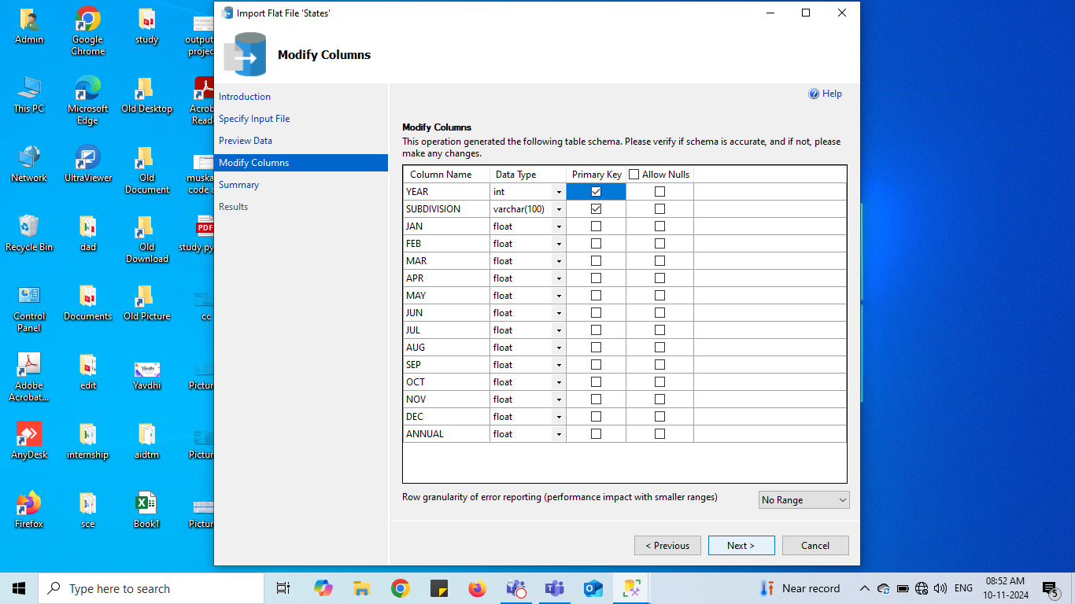
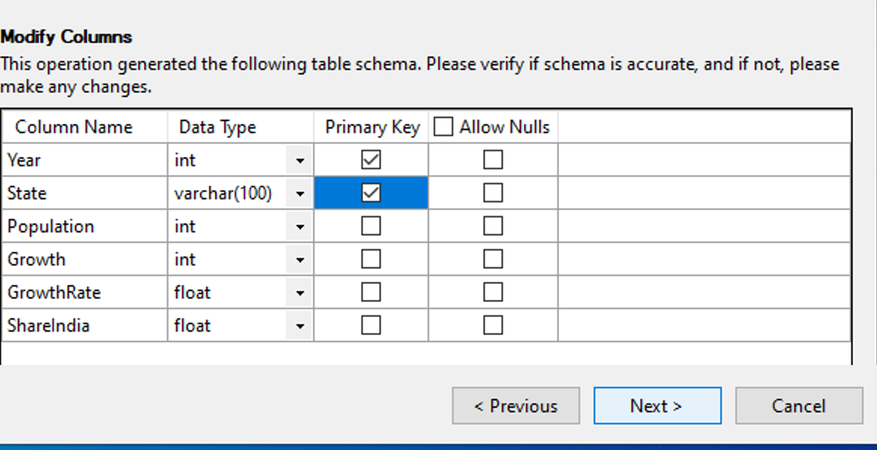
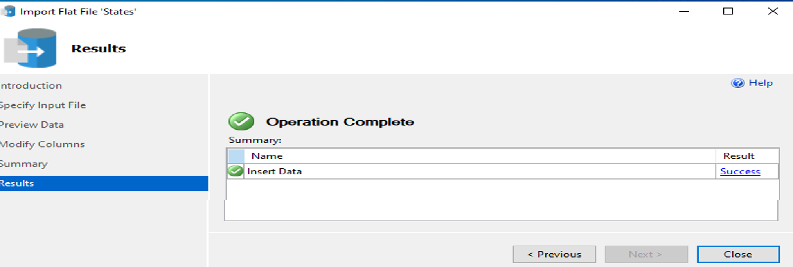
Modify Columns
For Rain Table
For Gujarat Table
For Maharashtra Table
Result:

Slide 4
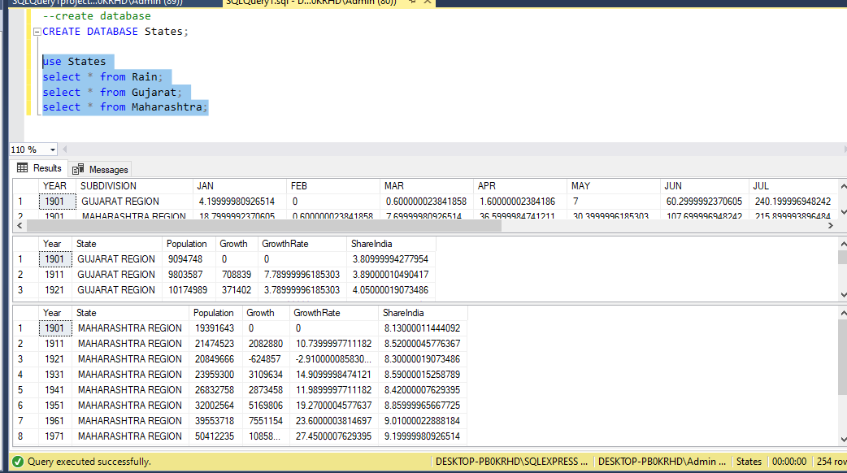
Retrieve Data from the table in database
Retrieved Data from all three tables in database: Rain, Gujarat and Maharashtra

Slide 5
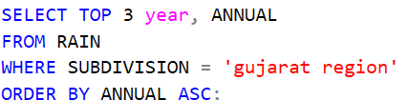
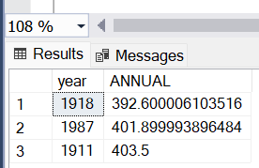
1. Which are Top 3 years when GUJARAT has minimum rainfall?
Interpretation and Insights
Analysis :
Identifying drought patterns.
Guiding water management and crop planning.
Rainfall Trends (1911-1987):
Stability with minor fluctuations observed.
Indicates generally consistent weather.
Key Data Points:
Highest rainfall: 1911 (403.5 mm).
Second-highest: 1987 (401.9 mm).
Lowest rainfall: 1918 (392.6 mm).
Implications:
These slight change may impact agriculture and Adjustments required in water management for annual variations.
Code:
Output:
Notes:
Analyzing extreme rainfall years helps identify drought patterns, and guide water management, and crop planning. Rainfall data from 1911 to 1987 shows stability with minor fluctuations, indicating consistent weather. The highest rainfall was in 1911 (403.5 mm), followed by 1987 (401.9 mm), and the lowest in 1918 (392.6 mm). These slight changes could impact agriculture and water management, requiring adjustments for annual variations.

Slide 6
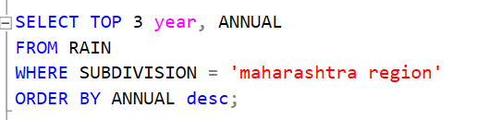
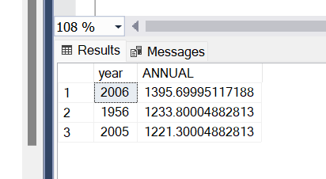
2. Which are Top 3 years when MAHARSHTRA has maximum rainfall?
Code:
Interpretation and Insights
Key Data Points:
2006 had the highest rainfall (1395 mm), indicating a relatively wet year.
1956 (1233 mm) and 2005 (1221 mm) had similar rainfall levels, showing a moderate variation in annual rainfall.
Implications:
The larger increase in 2006 might require extra focus on flood prevention or better management of surplus water.
Output:

Slide 7
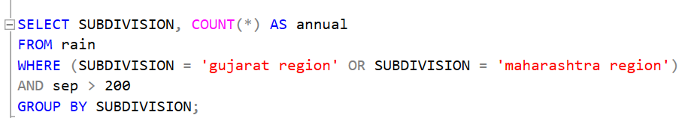
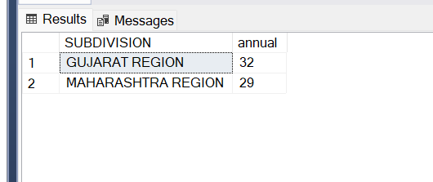
3. How many times Gujarat and Maharashtra has rainfall higher than 200mm in month of September?
Code:
Interpretation and Insights
Rainfall Comparison (September):
Gujarat had slightly more rainfall exceeding 200 mm in September than Maharashtra.
Gujarat experienced 3 more occurrences of rainfall above 200 mm.
Output:

Slide 8
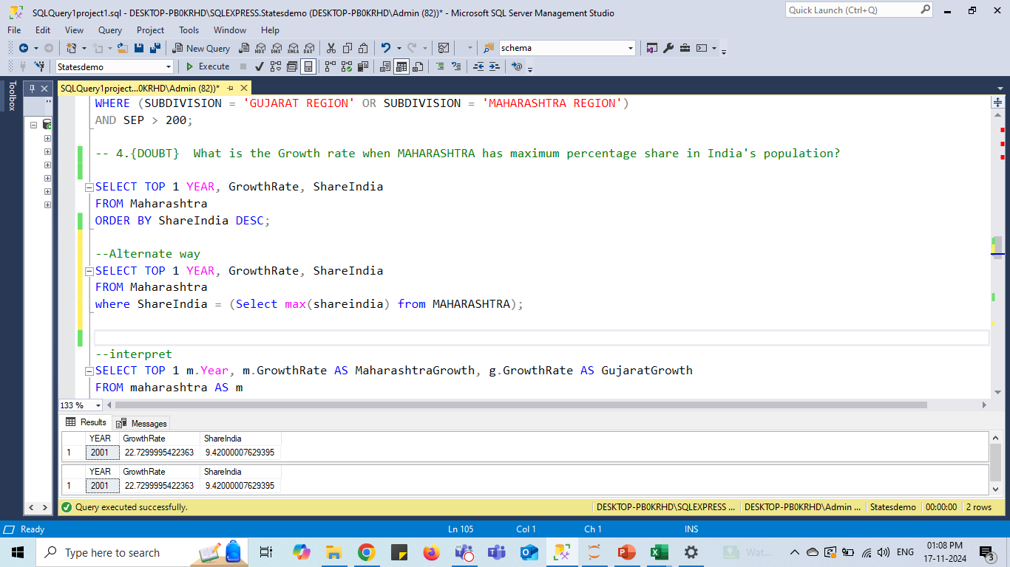
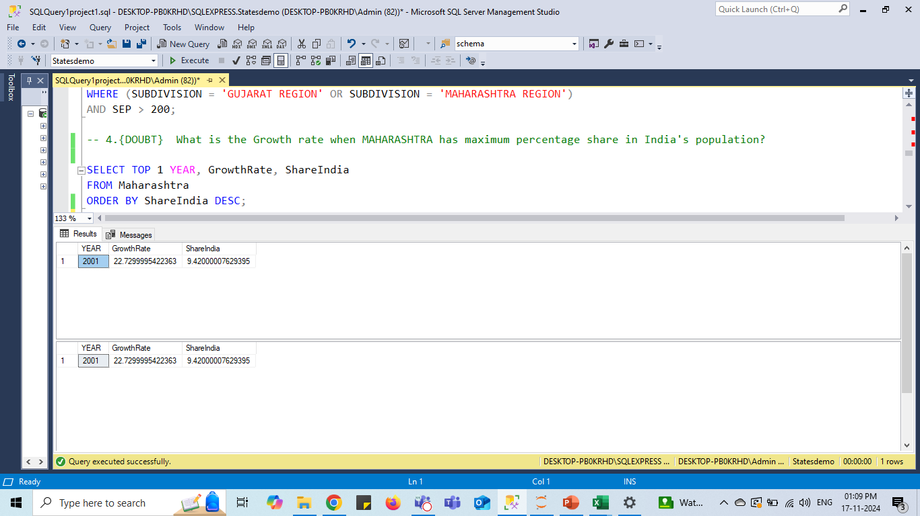
4. What is the Growth rate when MAHARASHTRA
has maximum percentage share in India's population?
Code:
Interpretation and Insights
Population Growth (2001):
2001(Maharashtra) population grew by 22.73%.
Share of India's Population:
Maharashtra contributed 9.42% to India's total population.
This means nearly 1 in 10 people in India were from Maharashtra.
The state's significant population growth highlights its demographic role in India.
Implications:
Insights can help guide government investments in areas like:
Public infrastructure.
Housing.
Employment opportunities.
Output:

Slide 9
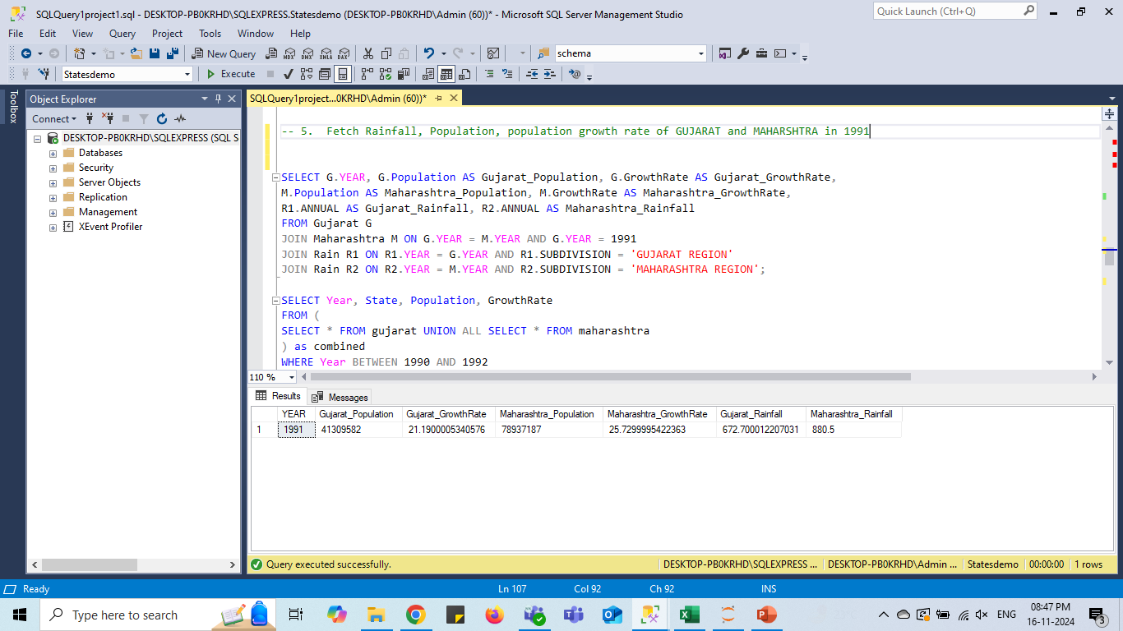
5. Fetch Rainfall, Population, population growth rate of GUJARAT and MAHARSHTRA in 1991.
Interpretation and Insights
Population: Maharashtra has a much larger population (78.94 million) than Gujarat (41.31 million).
Growth Rate: Maharashtra's population growth rate (25.73%) is higher than Gujarat’s (21.19%), indicating faster population expansion in Maharashtra.
Annual Rainfall: Maharashtra received 880.5 mm of rainfall, higher than Gujarat's 672.7 mm, influencing water resources and agricultural conditions.
Economic Implication: The larger population and higher growth rate in Maharashtra suggest greater economic activity, with potential challenges in infrastructure and resource management.
Code:
Output:

Slide 10
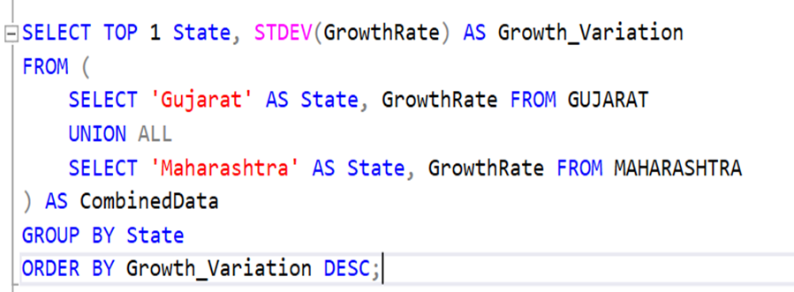
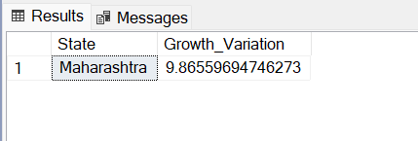
6. Which state experiences greater variation in Population growth year over year?
Code:
Interpretation and Insights
Population:
Maharashtra has a larger population and has growth rate than Gujarat.
Variation in Growth:
Maharashtra experiences a greater variation in population growth year-over-year, with a growth variation of 9.87%.
Indicates more fluctuating growth patterns compared to Gujarat, which could be linked to factors like migration, economic shifts, and urbanization..
Output

Slide 11
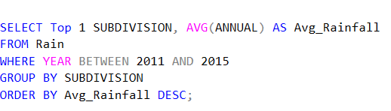
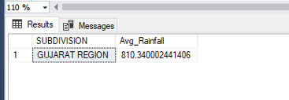
7. Which state received more rainfall on average over a years 2011 to 2015?
Interpretation and Insights
Rainfall Comparison (2011-2015):
Gujarat received more average rainfall (810.34 mm) than Maharashtra (797.46 mm).
Consistency:
Gujarat experiences more consistent precipitation, despite Maharashtra's varied topography with areas like the Western Ghats receiving heavy rainfall,.
Implications:
Average rainfall data supports
budgeting, disaster preparedness, and financial resilience. Higher rainfall in Gujarat benefits hydropower reliability, while lower rainfall in Maharashtra may drive investments in alternative energy.
Code:
Output:

Slide 12

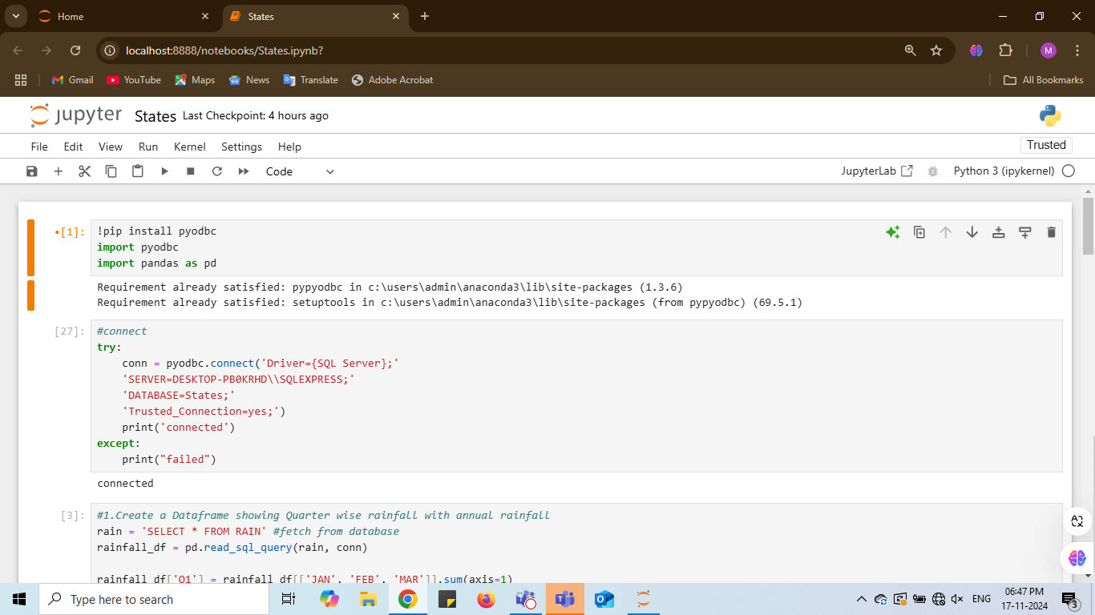
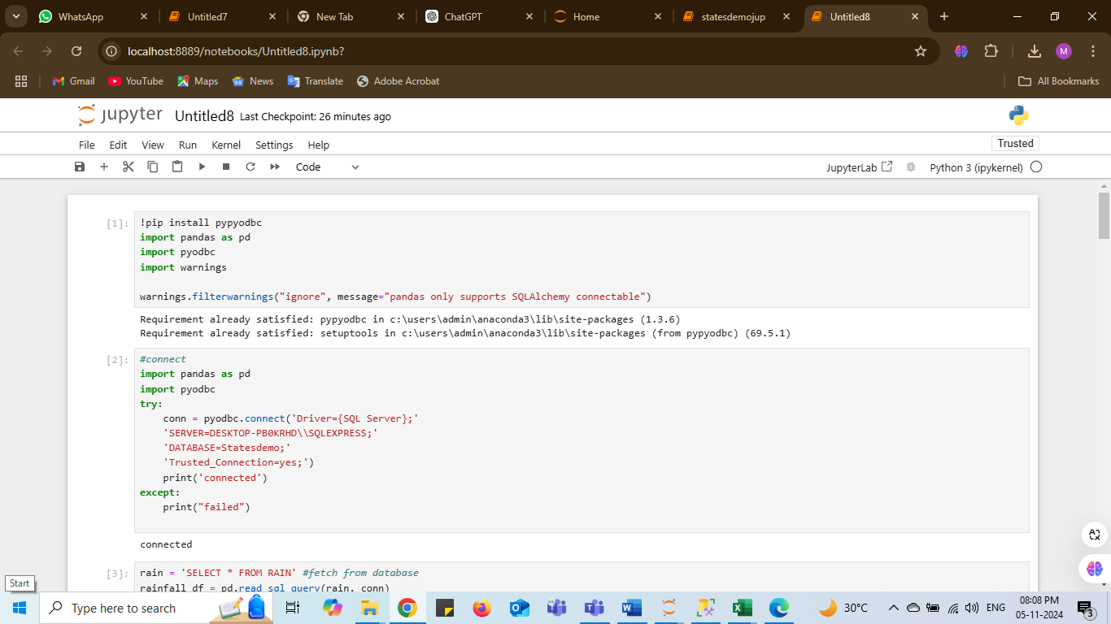
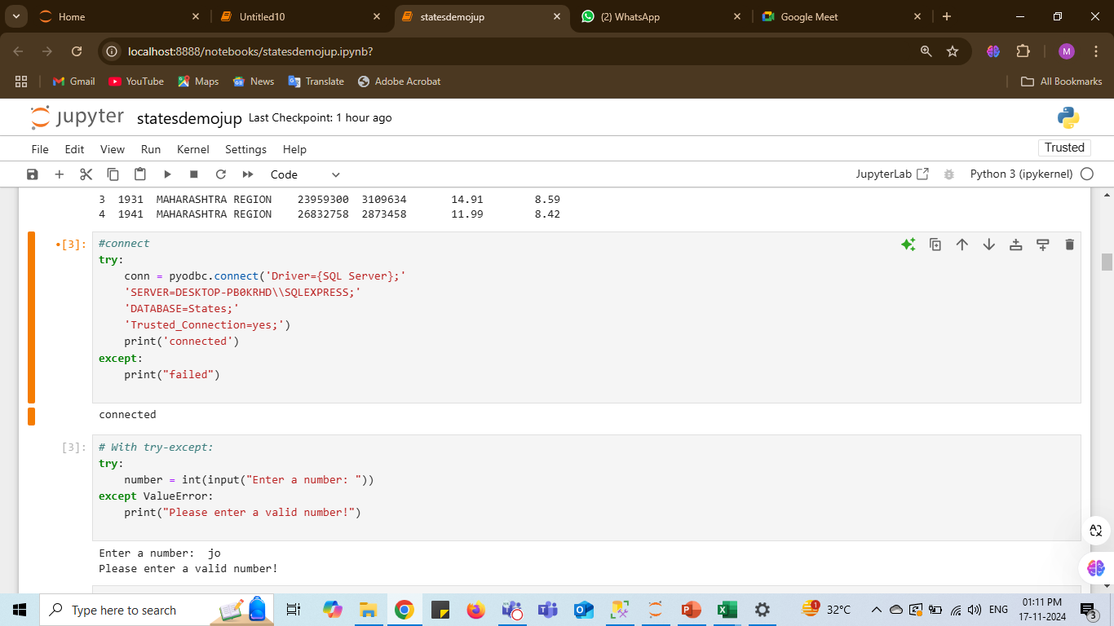
Python Connectivity
Code:
Output:
Code:
Output:

Slide 13
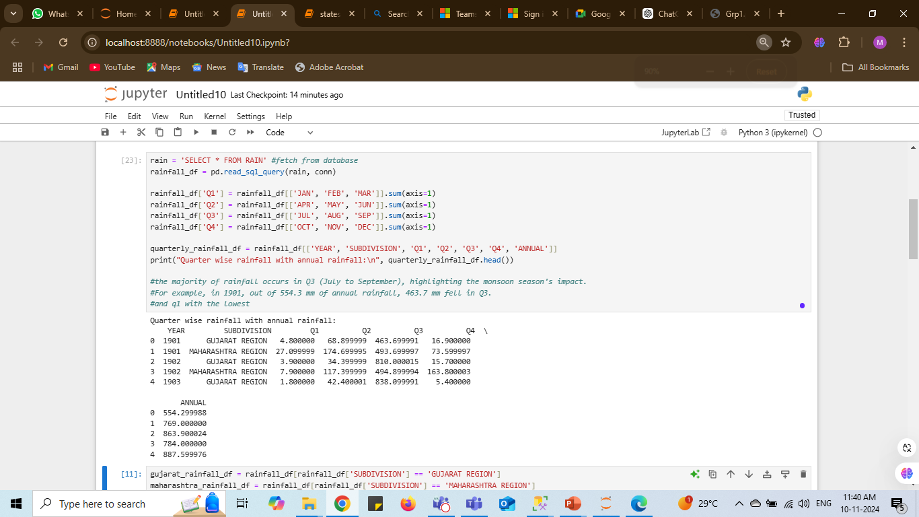
1. Create a Dataframe showing Quarter wise rainfall with annual rainfall
Code:
Interpretation and Insights
Quarterly Rainfall Analysis:
Most precipitation occurs in Q3, particularly during the monsoon season.
For example, in 1901, Q3 received 463.7 mm out of a total of 554.3 mm.
Geographic and Climatic Factors:
Areas affected by the monsoon experience concentrated rainfall during these months, while other seasons, especially Q1 and Q4, receive comparatively less precipitation.
Output:

Slide 14
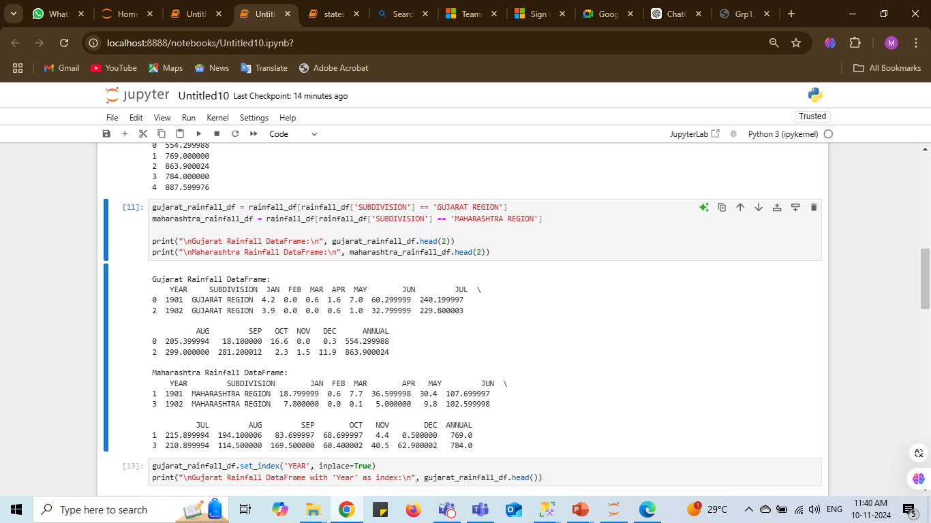
2. Separate a Dataframes of Gujarat and Maharashtra Rainfall
Code:
Interpretation and Insights
Maharashtra's larger population base may face different water management challenges compared to Gujarat.
Output:

Slide 15
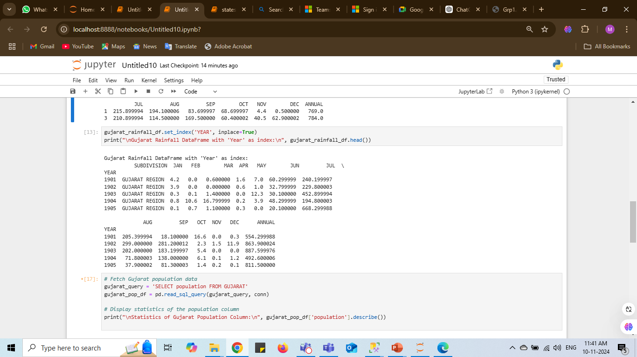
3. Use Year as index in Gujarat Dataframe of Rainfall
Code:
Interpretation and Insights
Rainfall Fluctuation:
Gujarat experiences significant year-to-year variation in rainfall, with monsoon months (June to August) receiving the most.
Examples:
1903 had 887.6 mm of rainfall, while 1904 had only 492.6 mm.
Output:

Slide 16
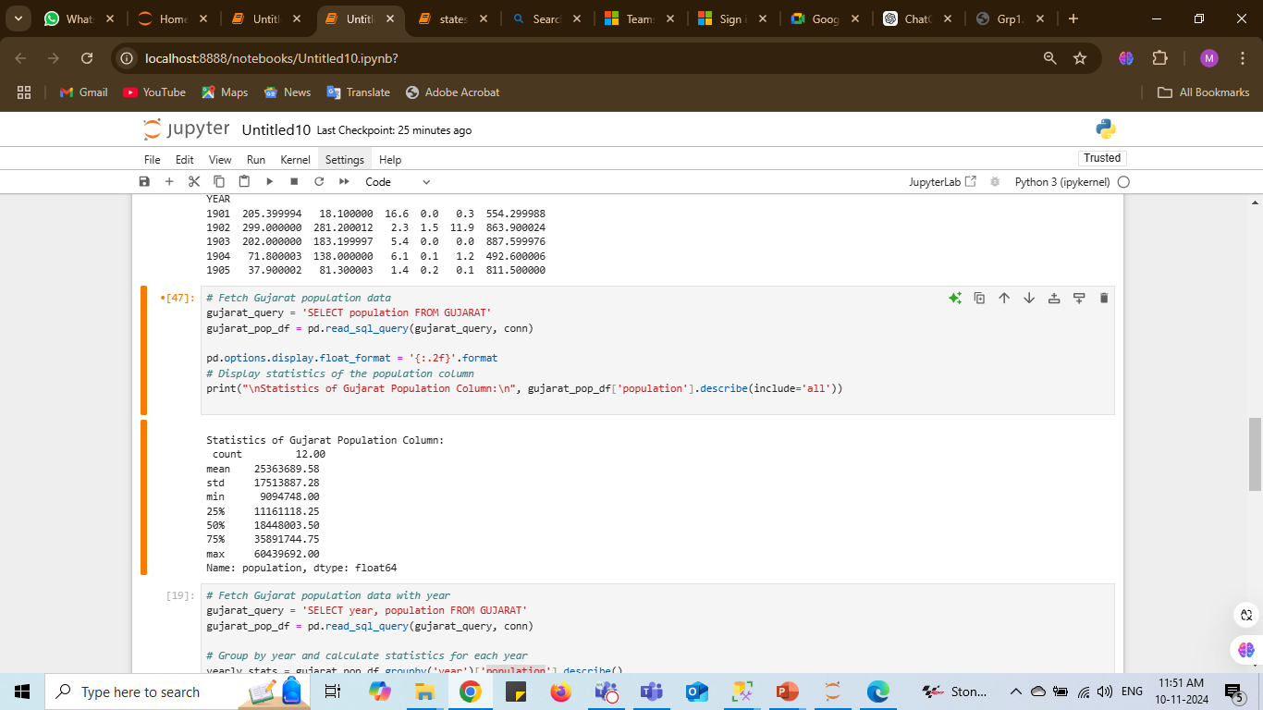
4. Print the statistics of Gujarat Population Dataframe
Code:
Interpretation and Insights
Population Growth:
Gujarat’s population has grown significantly, with an average of 25.36 million and notable variation.
The lowest recorded population value is 9.09 million
The highest recorded population value is 60.44 million
Output:
Notes:
25% (1st Quartile or Q1):
This is the value below which 25% of the data fall. In your case, 11.16 million is the population value below which 25% of the population data points lie.
50% (Median or Q2):
This is the middle value in the dataset, where 50% of the values are above and 50% are below. For your data, 18.45 million represents the median population.
75% (3rd Quartile or Q3):
This is the value below which 75% of the data fall. In your case, 35.89 million is the population value below which 75% of the data points lie.

Slide 17
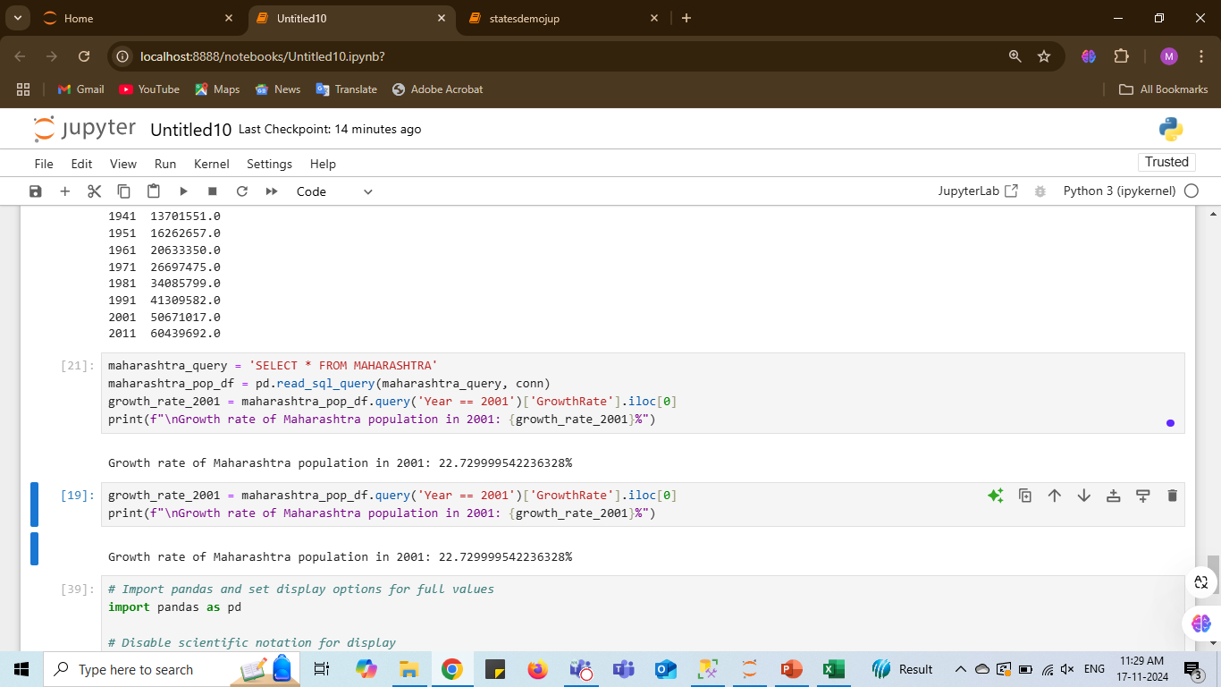
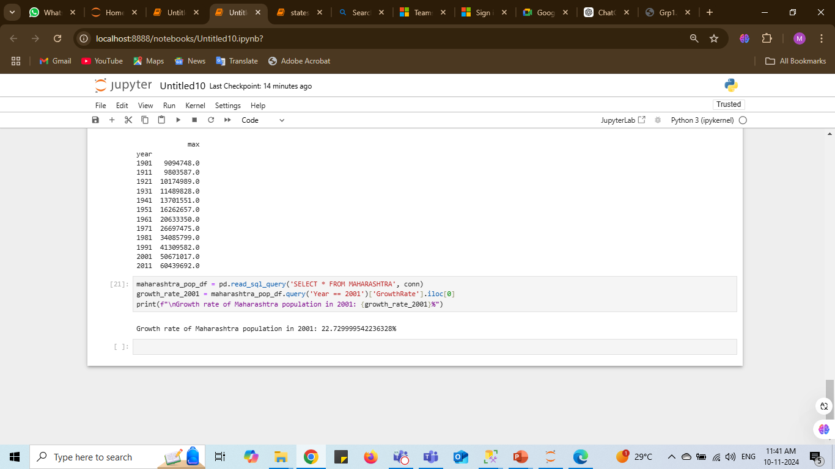
5. Print the growth rate of Maharashtra population in year 2001.
Code:
Interpretation and Insights
Population Growth (2001):
In 2001, Maharashtra’s population growth rate was 22.73%, indicating a significant growth period.
Factors Driving Growth:
Influenced by urbanization and migration, leading to a rapid increase in the population.
Implication:
Investing in public transit is essential to reduce reliance on personal vehicles and manage the growing population.
Output:

Slide 18
THANK YOU

